Slide 1
Stationery Store Project
Presented by:
Elghandour Abdelrahman

Slide 2
Table of contents
- Presenting website features and functionalities
- Presenting Excerpts of the code
- Presenting mistakes that I made.
- Lessons learnt while building the project
Potential enhancements

Slide 3
Website features

Slide 4
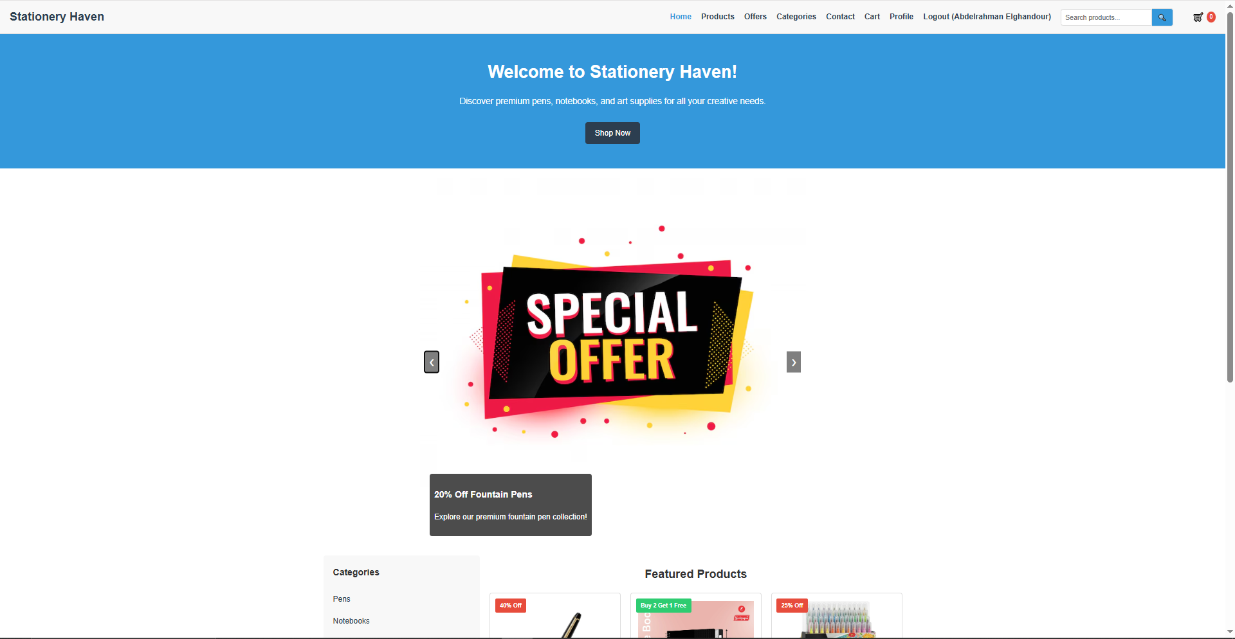
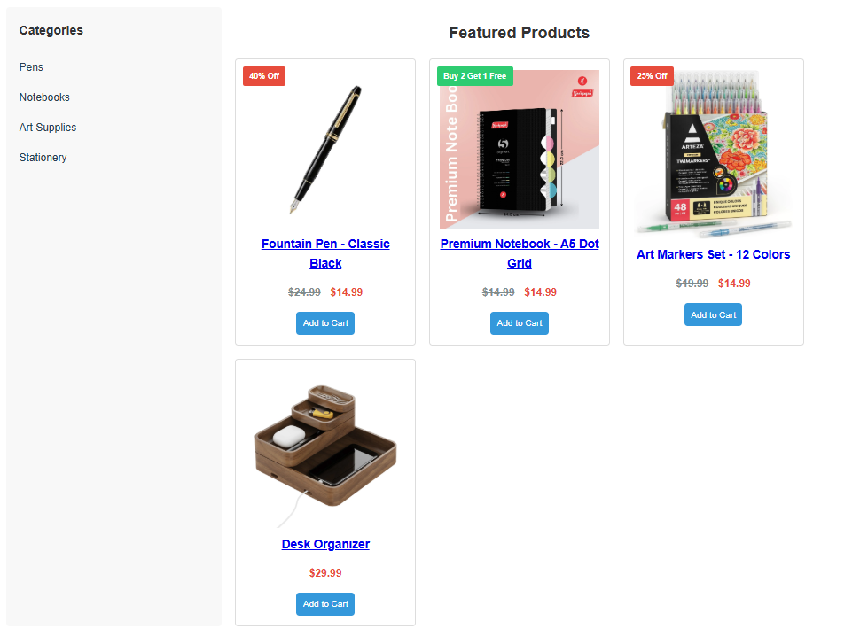
Website home page

Slide 5
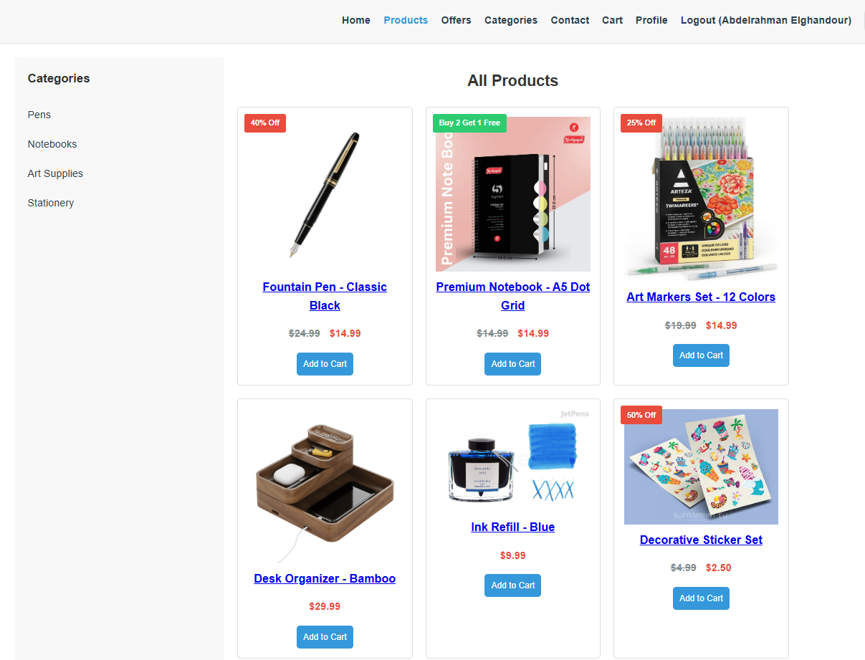
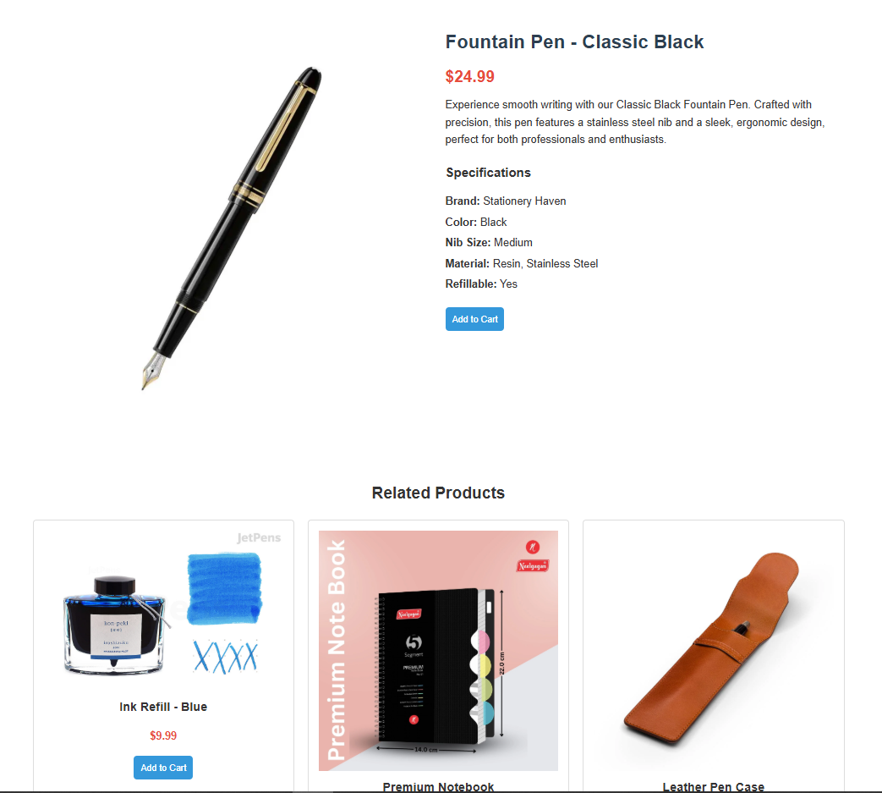
Header + products page + each product unique page

Slide 6
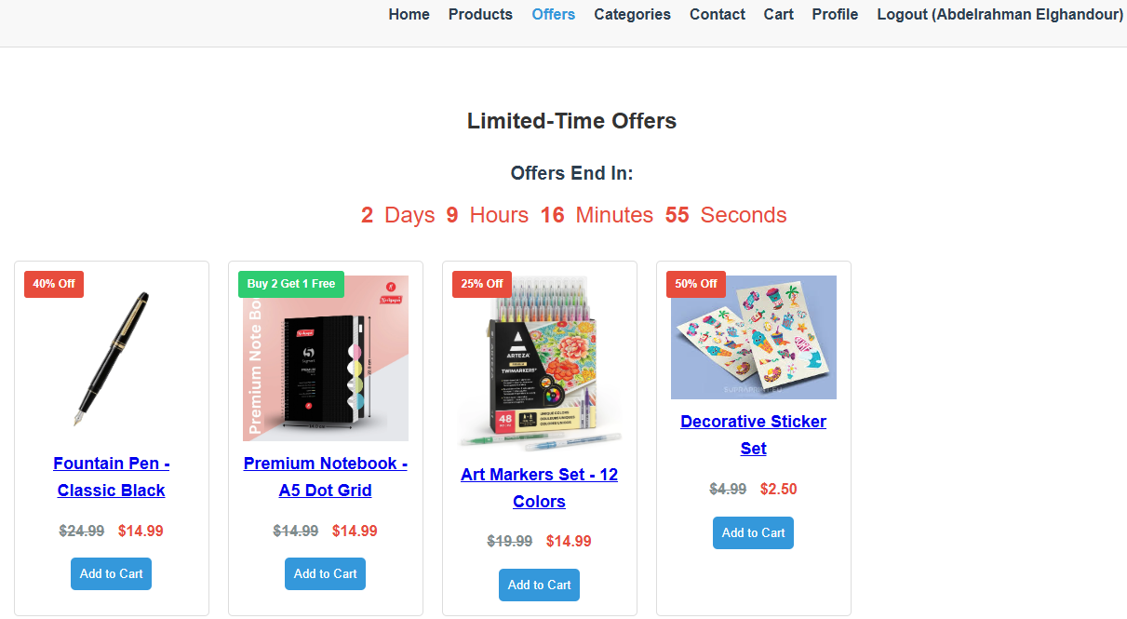
Offers page with limited time offers

Slide 7
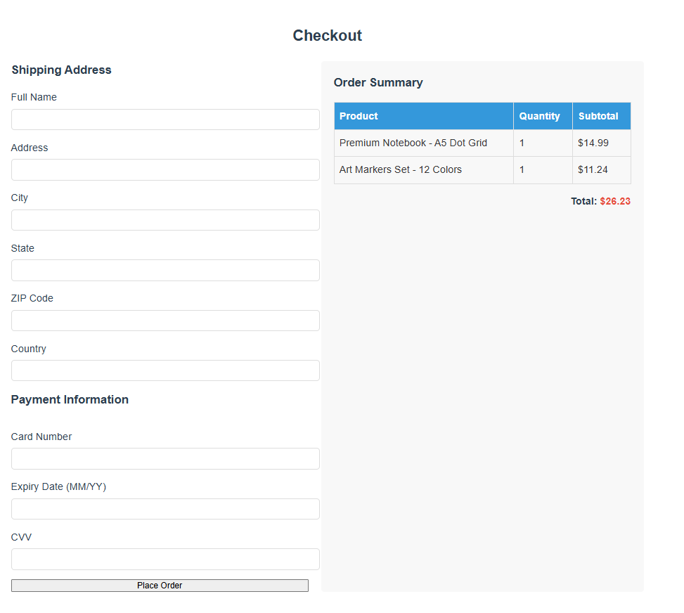
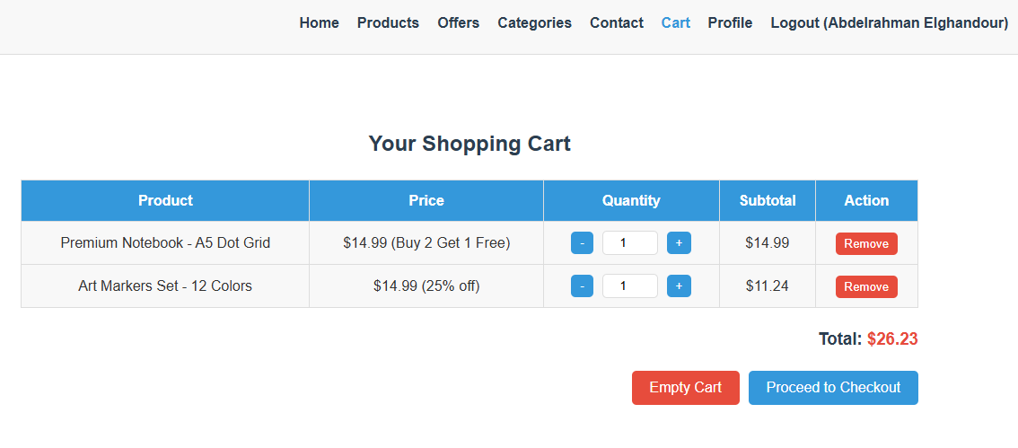
Cart and checkout pages

Slide 8
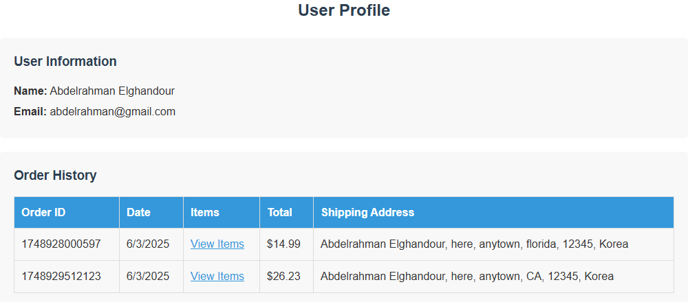
User profile and order history

Slide 9
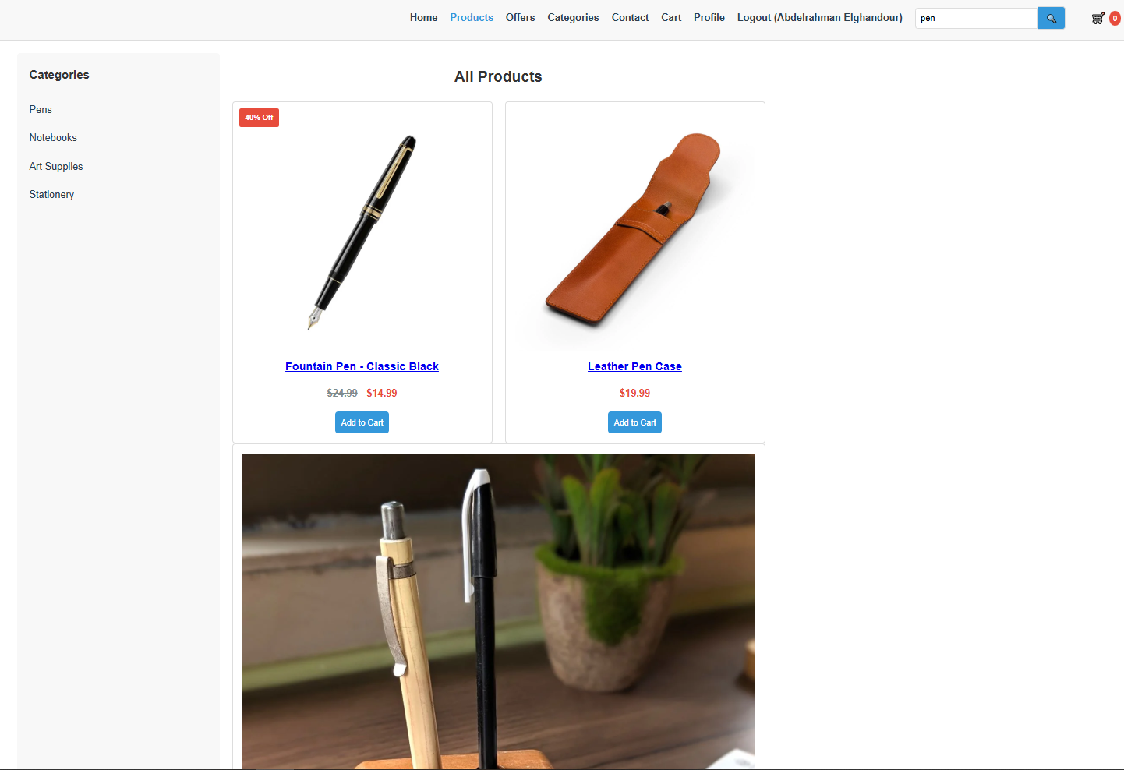
Search bar filtering

Slide 10
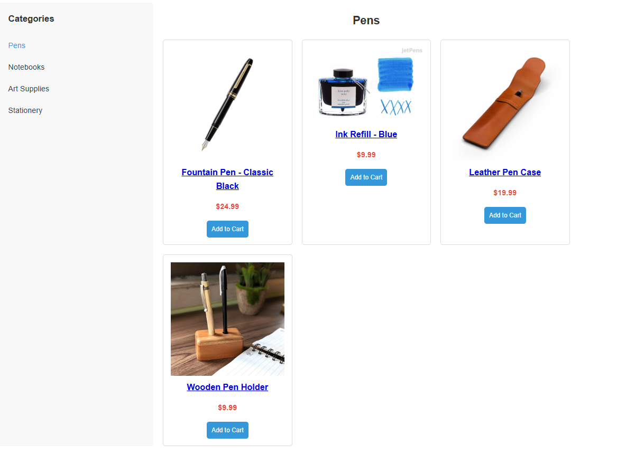
Category side bar

Slide 11
Code excerpts

Slide 12


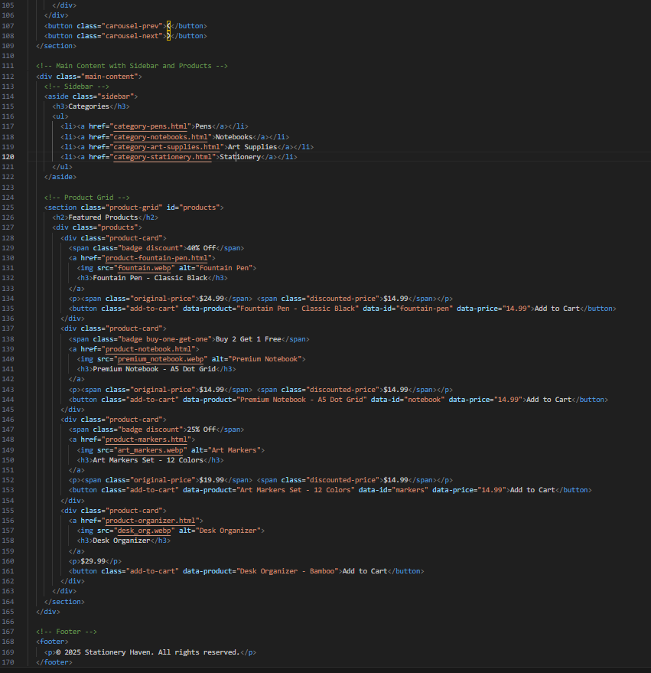
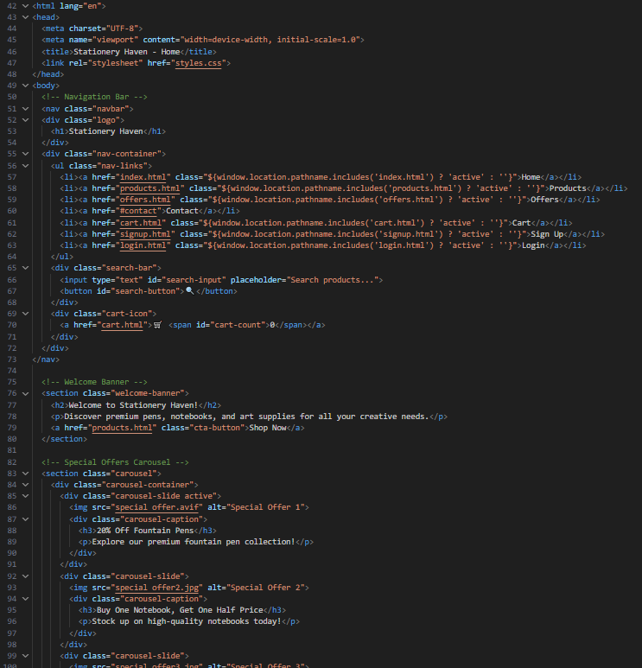

Index File

Slide 13
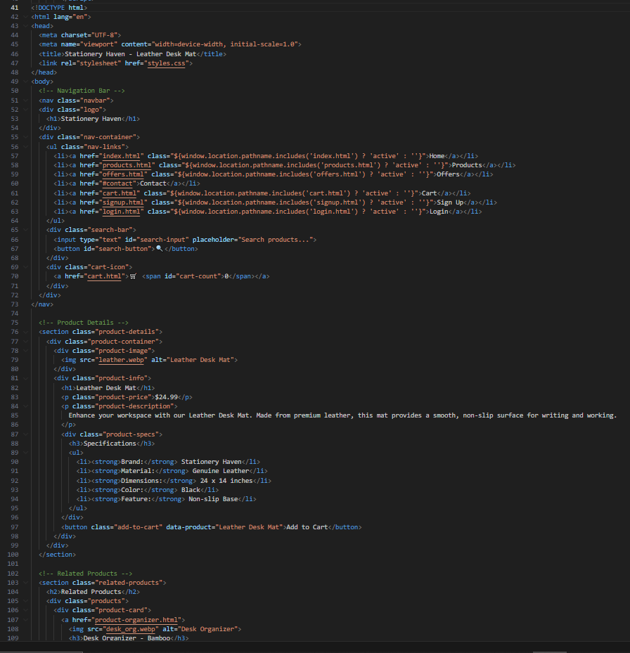
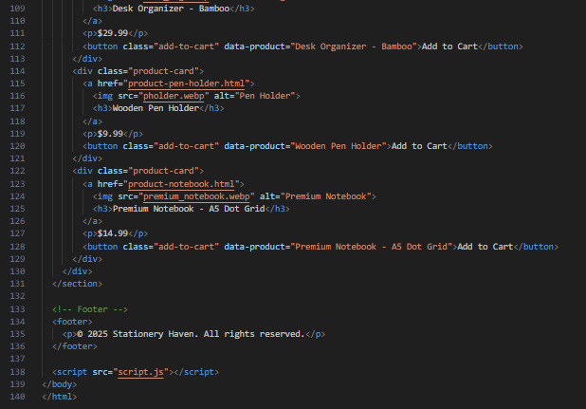
An Example of a product page

Slide 14
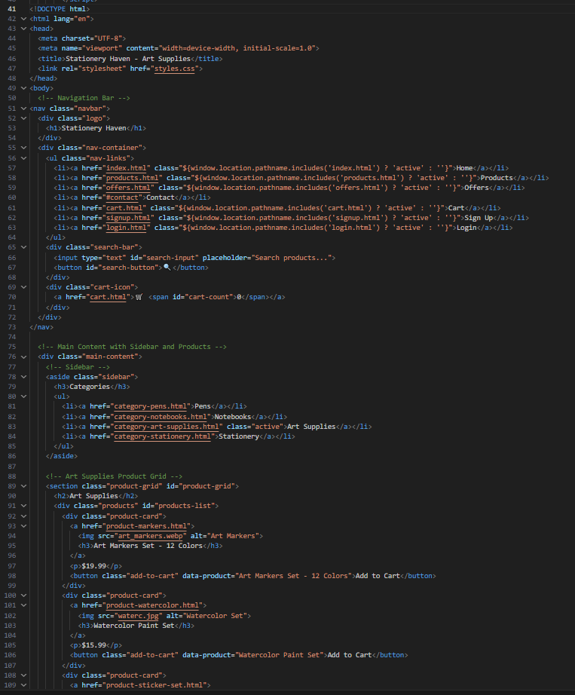
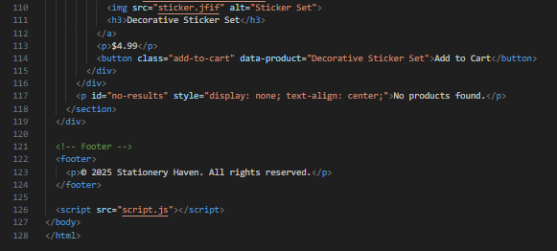
An example of a category page

Slide 15
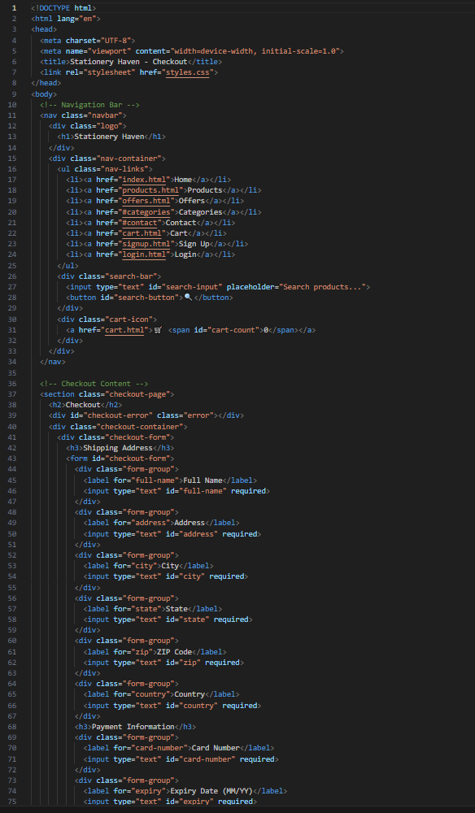
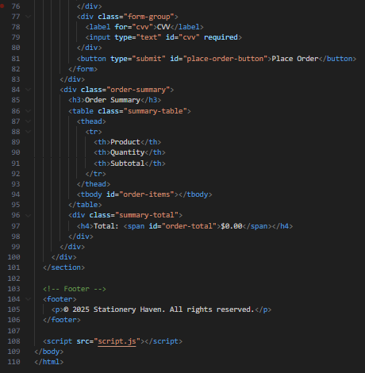
Checkout page

Slide 16
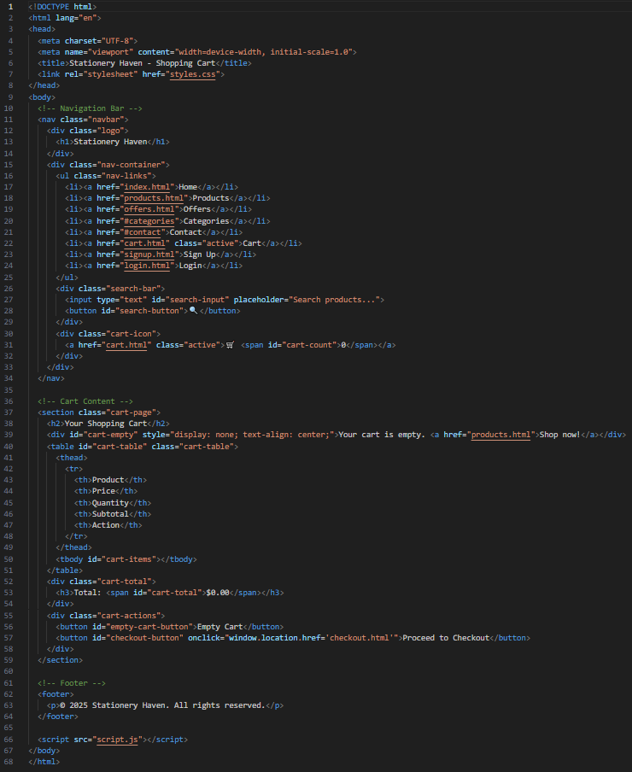
Cart page

Slide 17
CSS styling excerpts

Slide 18
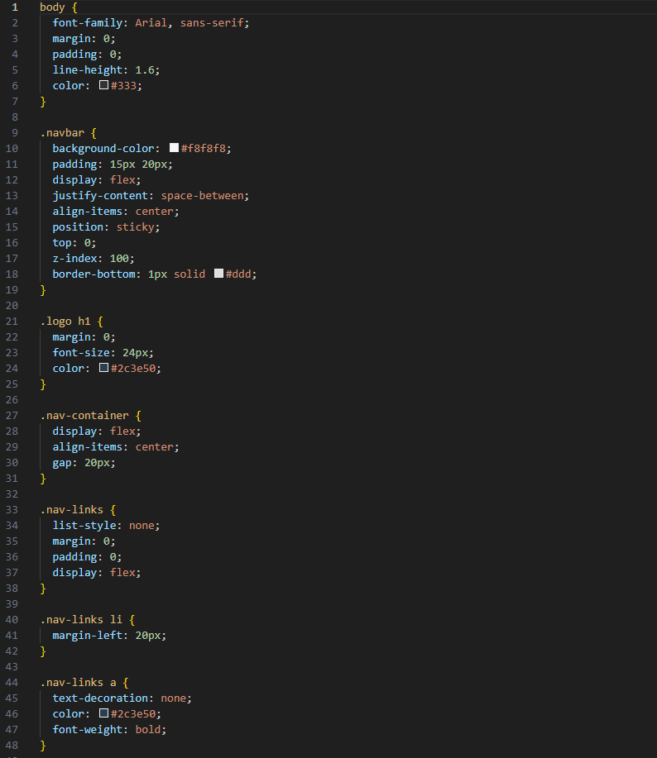
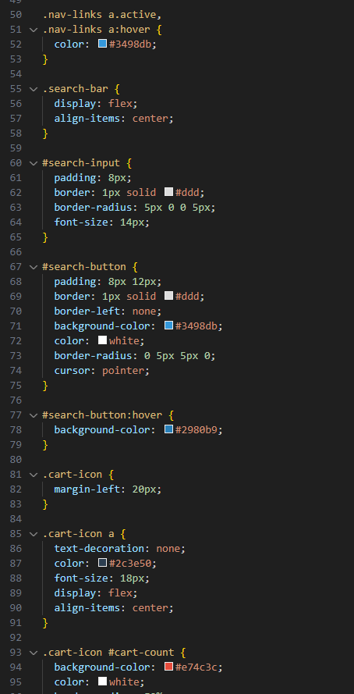
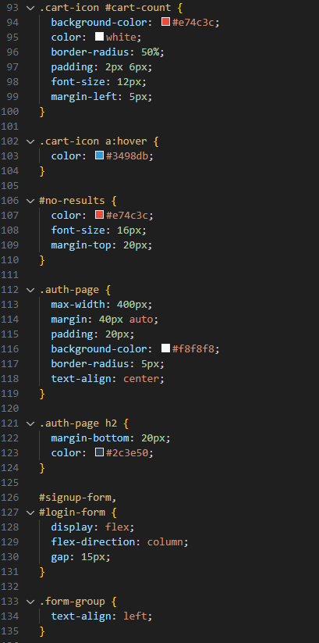

Slide 19
CSS code is almost 1000 lines of code, so it would be difficult to show all of it☹

Slide 20
JavaScript code excerpts

Slide 21
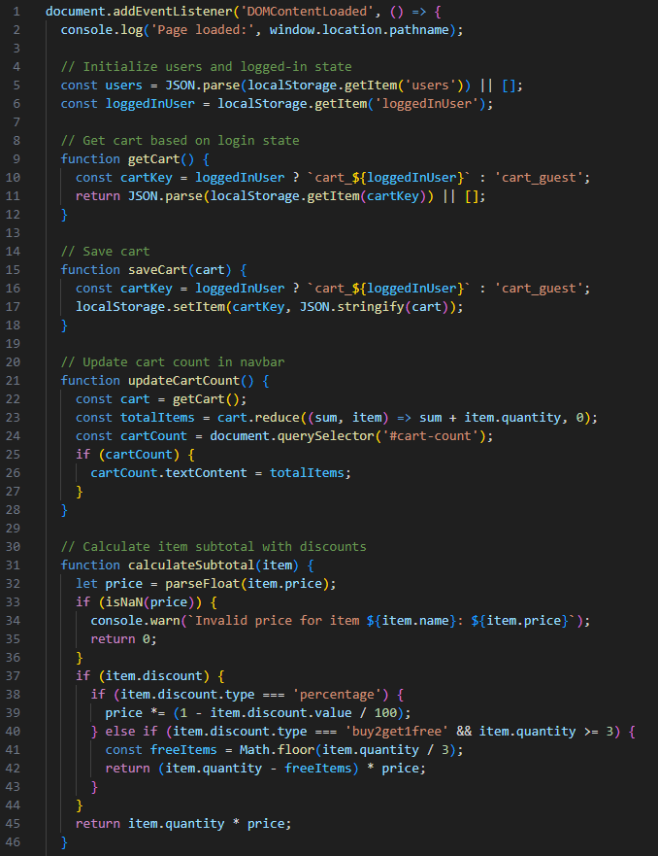
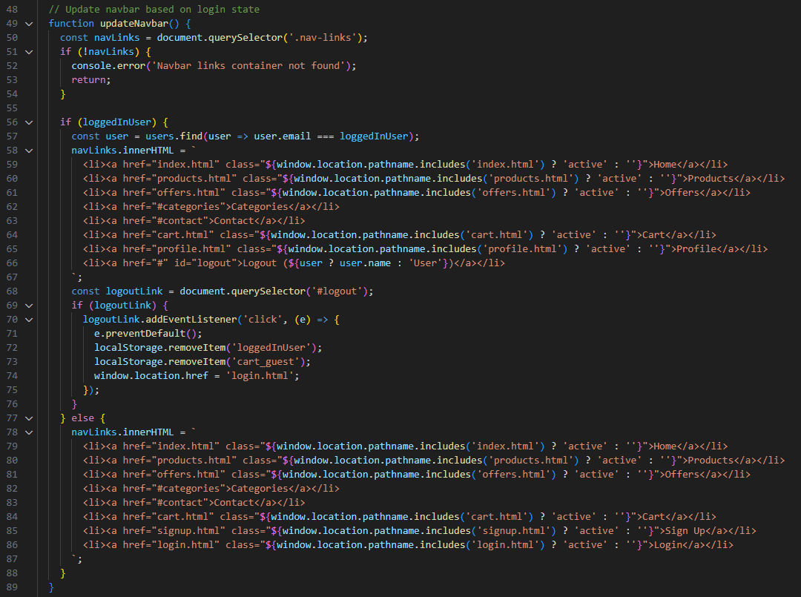

Slide 22
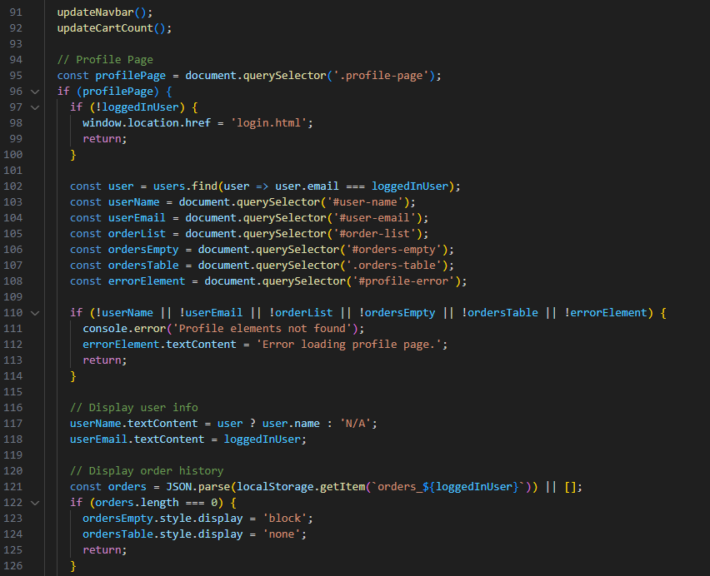
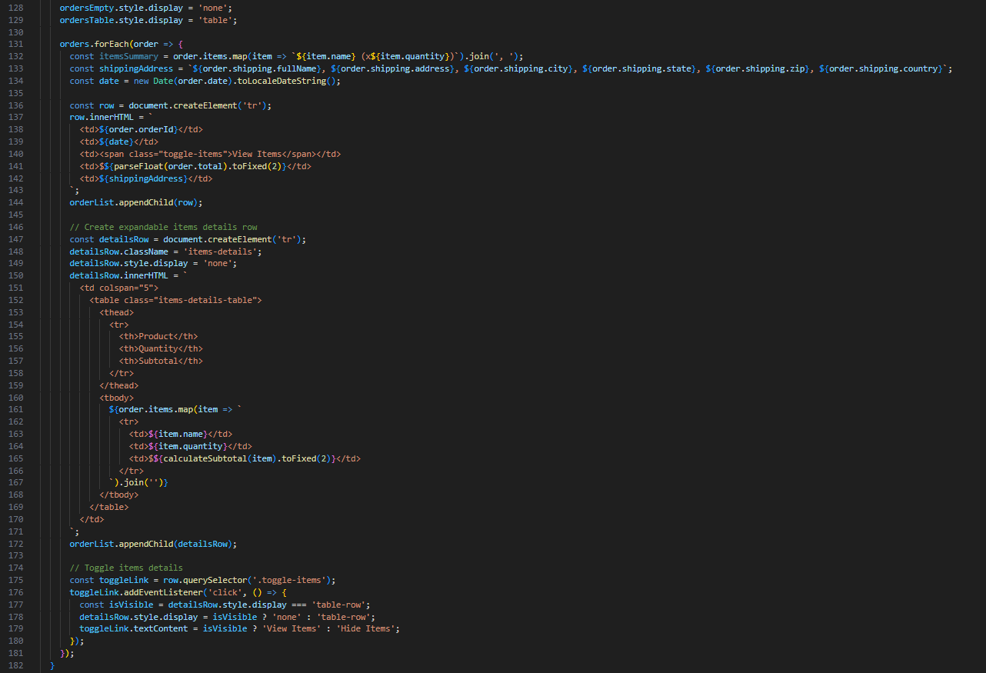

Slide 23
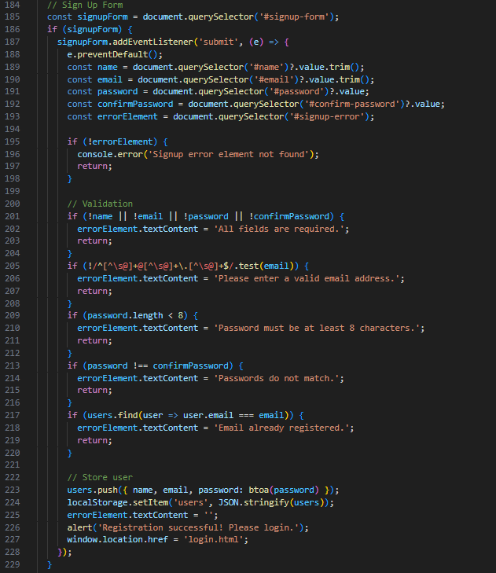
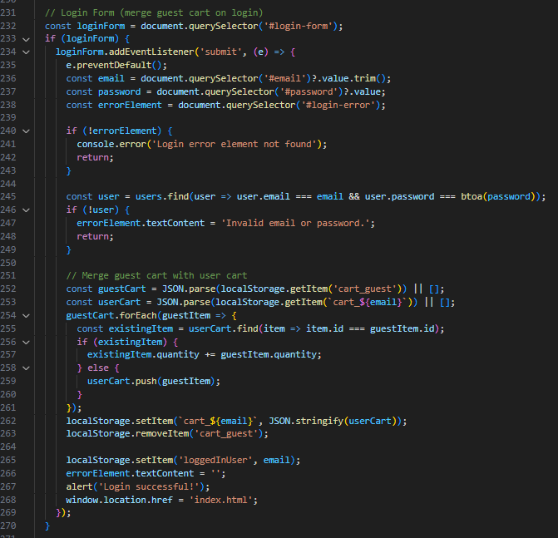

Slide 24
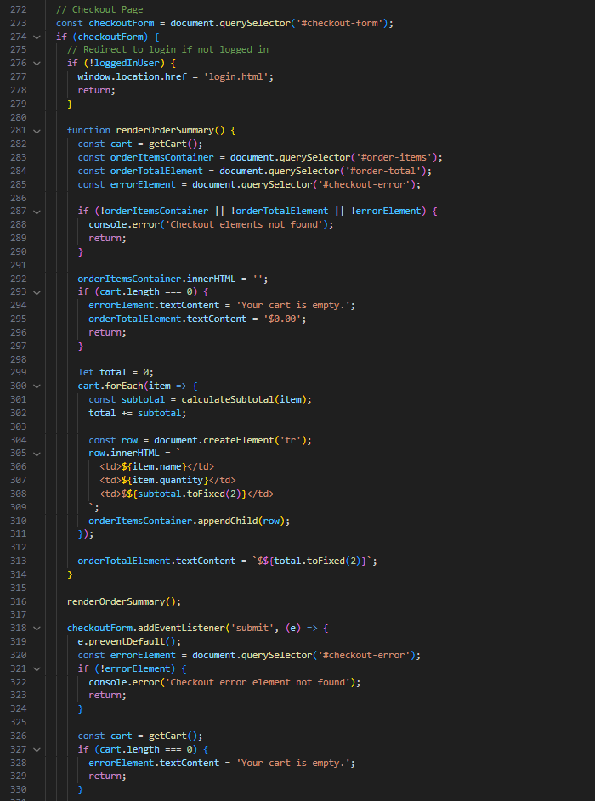
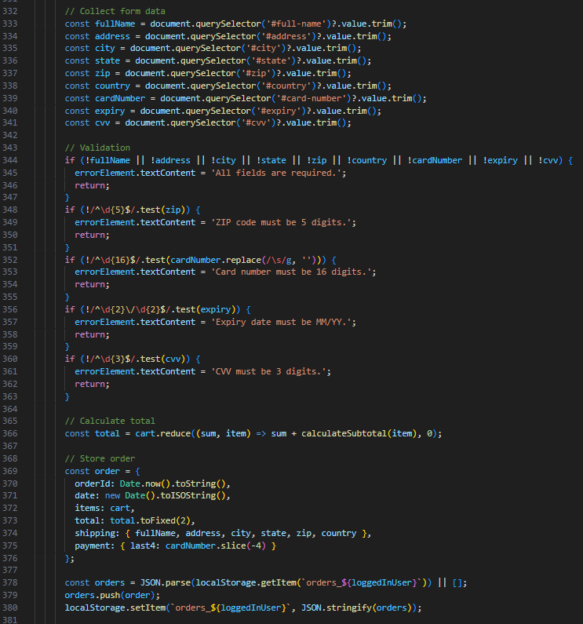
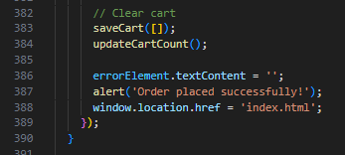

Slide 25
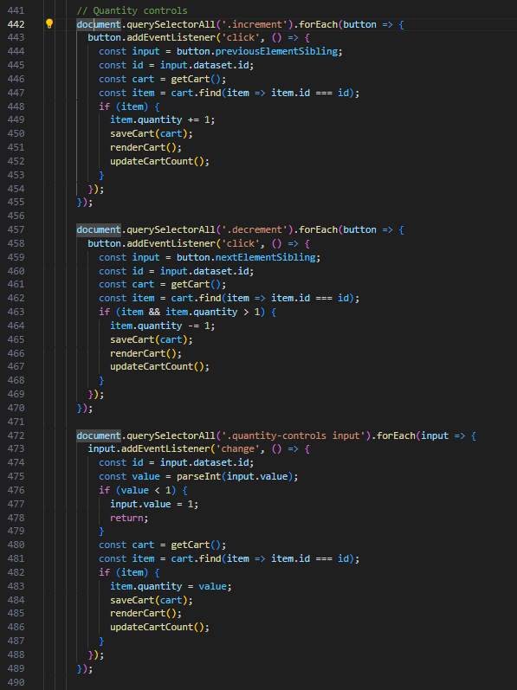
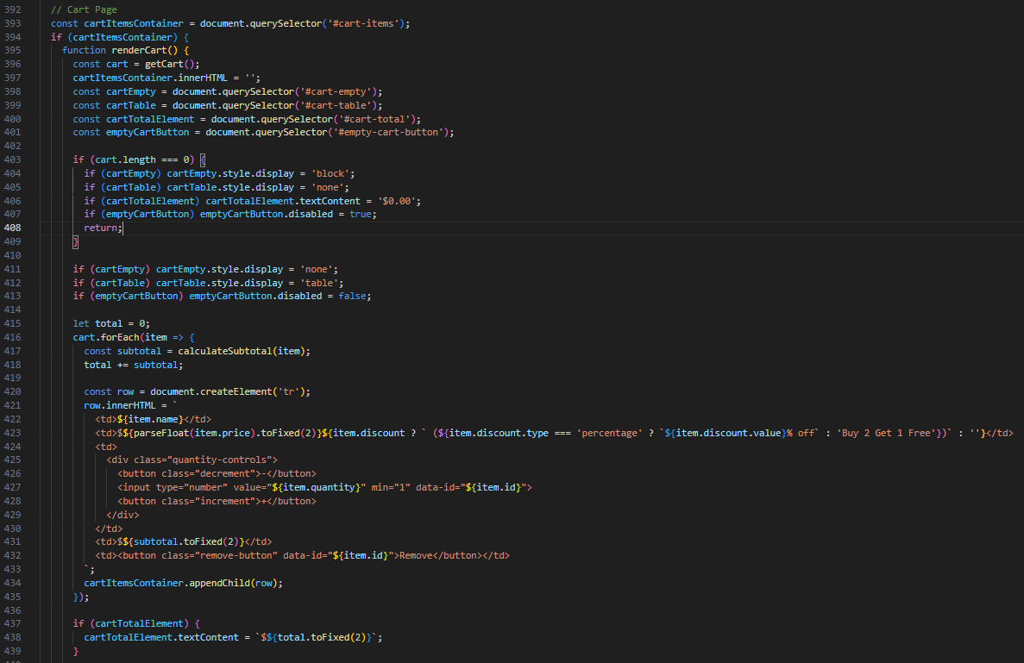

Slide 26
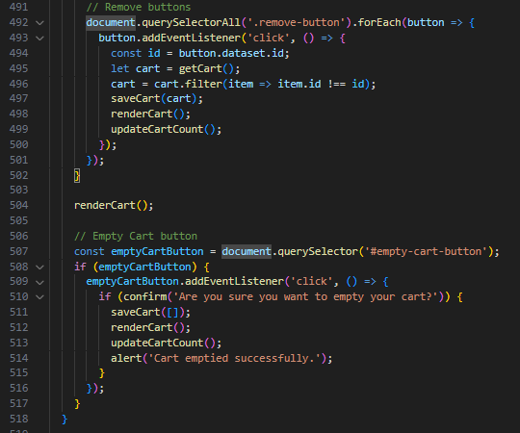
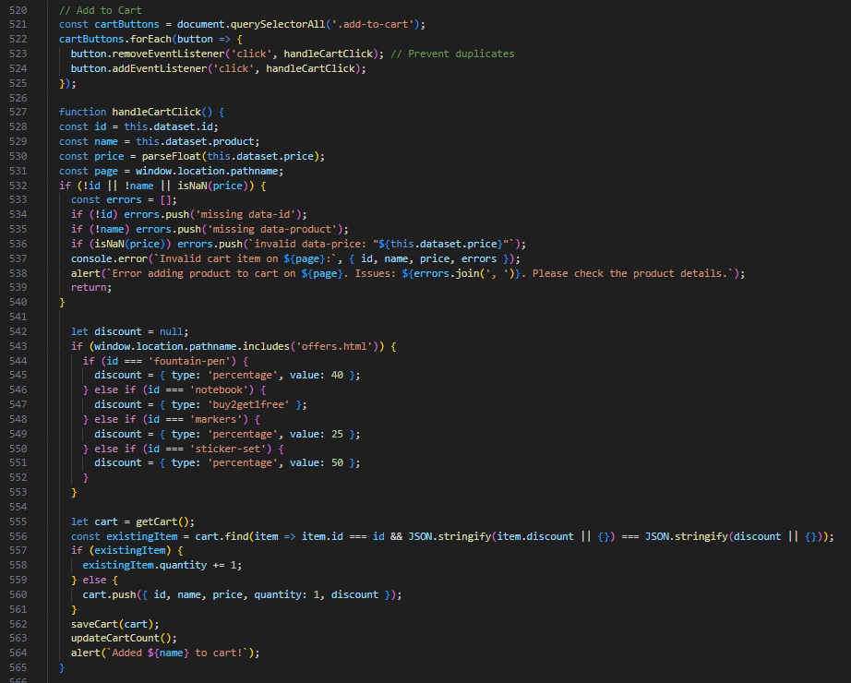

Slide 27
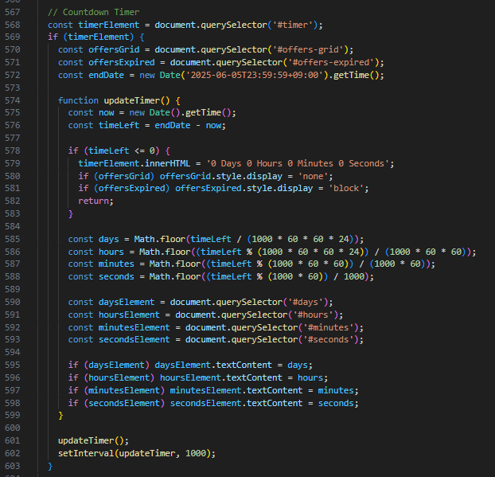
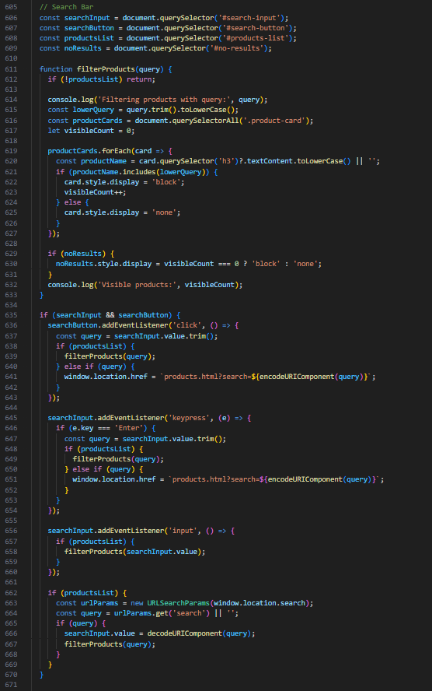

Slide 28
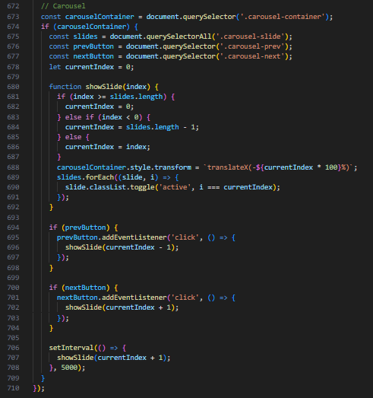
That’s the whole JS code☺

Slide 29
Mistakes
Hard coding features that could have been added in a much smoother manner.
Not saving a branch on Git while trying to implement certain features that I am not fully confident I can implement
(Example: I tried to integrate a mogoDB database instead of the local storage by JS and I ended failing to implement it and spend 3 hours trying to get back to the zero point ☹)

Slide 30
Cont’d
Not using a JSON file for product management from the first place. Even though fetching from a JSON file would make the JS code much harder and longer, I realized how important it’s after the products became many and I kept repeating steps that could have been much easier using a JSON file.

Slide 31
Lesson
Get out of my comfort zone (The JSON file example)
Make a Git branch and then try whatever I want
If something feels like hard-coding I must search for sth that makes the process easier

Slide 32
Potential Enhancement (Development-wise)
As was mentioned earlier using a JSON file and changing the JS code so that it fetches data directly from it instead of html tag attributes would be much more convenient when developing the project in the future. Even though the user is not influenced by the change, it is important for the developer

Slide 33
Potential Enhancements (User-wise)
Adding multi-language support
Adding a confirmation page before payment
Maybe using some backend (depends on the available time)

Slide 34
Fixes
The nav bar and sidebar need to be collapsible in the media query so that mobile phone users can open and close it easily. Otherwise, they take so much space from the screen.

